Slide 1
Welcome to Web Scraping with Python!
Please log onto the Etherpad:
https://pad.carpentries.org/2026-03-18-bham-web-scraping-Python
Add your details in the ‘Sign in’ section
Check if you have completed the Software Setup’

Slide 2
“Web scraping (web harvesting or web data extraction) is a computer software technique of extracting information from websites.”
Wikipedia https://en.wikipedia.org/wiki/Web_scraping
Web scraping typically targets one web site at a time to extract unstructured information and put it in a structured form for reuse.

Slide 3
Web scraping might not be necessary
It might be possible (and quicker) to copy and paste data into a spreadsheet (probably only for small amounts of data)
Data may be available for download on a website
An API (application programming interface) may be provided for extraction of data
For much larger needs, Freedom of information Act (FOIA) requests can be useful. Be specific about the formats required for the data you want.

Slide 4
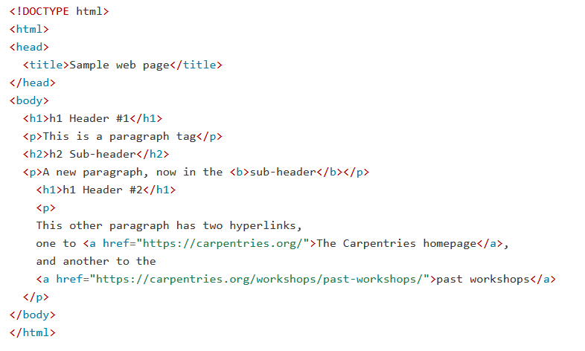
Hypertext Markup Language – html

Slide 5
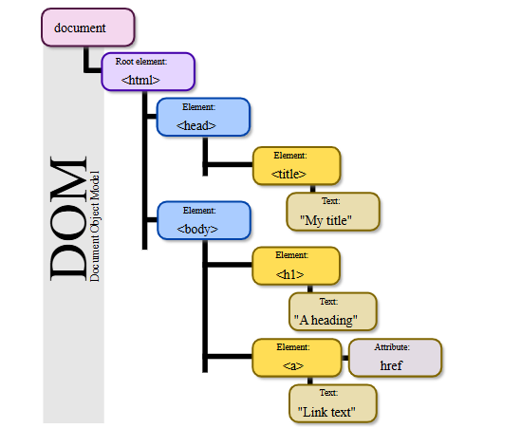
html Tree Format
Source: Wikipedia. Author: Birger Eriksson

Slide 6
html tags
<hmtl>...</html> The root element that contains the entire document.
<head>...</head> Contains metadata such as the page title that the browser displays.
<body>...</body> Contains the content that will be shown on the webpage.
<h1>...</h1>, <h2>...</h2> Define headers of levels 1, 2, 3, and so on.
<p>...</p> Represents a paragraph.
<a href="">...</a> Creates a hyperlink; the destination URL is set with the href attribute.
<img src="" alt=""> Embeds an image, with the image source specified by `src` and alternative text provided by `alt`. It doesn't have an opening tag.
<table>...</table>, <th>...</th>, Define a table structure, with headers (`<th>`), rows (`<tr>`),
<tr>...</tr>, <td>...</td> and cells (`<td>`).
<div>...</div> Groups sections of HTML content together.
<script>...</script> Embeds or links to JavaScript code.

Slide 7
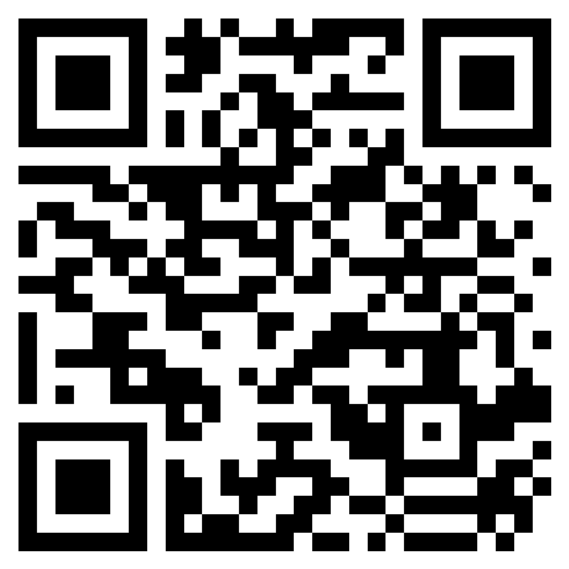
Please take a couple of minutes to fill in the feedback form
Web Scraping with Python - 18 Mar 2026 - BEAR Training Feedback form – Fill out form

Slide 8
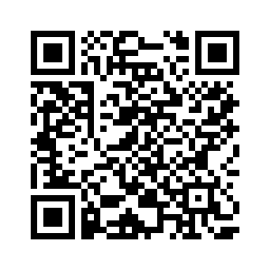

2026 IT Needs of Active Research Survey
Survey going live Monday 23 February for 4 weeks
Being sent to all research staff via new mailing list
PGR Leads being asked to send out to PGRs
Your opportunity to shape the future of research computing at UoB!
Received 5 years of funding for extra training based on 2024 results
Survey link
https://app.onlinesurveys.jisc.ac.uk/s/bham/2026-it-needs-of-active-research

Slide 9
Selenium ‘find’ instructions
.find_element() - finds first matching element
To select first <table> element:
driver.find_element(by=By.TAG_NAME, value=“table”)
To find a row with <tr class=“film”>:
driver.find_element(by=By.CLASS_NAME, value=“film”)
.find_elements() – finds all matching elements

Slide 10
The Scraping Pipeline
Understand the structure of the website
Determine whether the content is static or dynamic
Static content can be accessed directly using the ‘requests’ library and parsed using BeautifulSoup
Dynamic content is loaded or updated by JavaScript and typically requires Selenium to render the page before parsing
Build your scraping pipeline
Clean, format and store the data in a structured format. Pandas DataFrames may be used

Slide 11
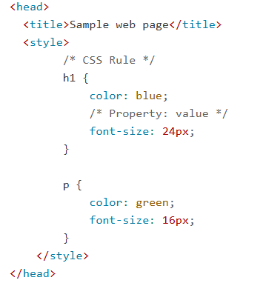
Cascading Style Sheet (CSS) Code

